Slide 1
STORE SALES FORECASTING
19BCP105 - Rishabh Teli
19BCP125 - Shrut Shah
19BCP127 - Shubham Kathiriya
19BCP138 - Vedant Patel

Slide 2
PROBLEM STATEMENT
In this project, looking at the various Stores Sales around the world are tasked with predicting their daily sales in advance.Store sales are influenced by many factors, including promotions, competition, school and state holidays, seasonality, and locality. With thousands of sales records we will be predicting sales based on their unique circumstances, the accuracy of results can be quite varied The task is to forecast the “Sales” column.

Slide 3
DATASET
Dataset contains sales for the thousands of product families sold at Favorita stores located in Ecuador.
The training data includes dates, store and product information, whether that item was being promoted, as well as the sales numbers.
Additional files include supplementary information that may be useful in building your models.

Slide 4
File Descriptions
TRAIN.CSV
The training data, comprising time series of features store_nbr, family, and on promotion as well as the target sales.
TEST.CSV
The test data, having the same features as the training data. You will predict the target sales for the dates in this file.
STORES.CSV
Store metadata, including city, state, type, and cluster.
OIL.CSV
Daily oil price. Includes values during both the train and test data timeframes.
HOLIDAY_EVENT.CSV
Holidays and Events, with metadata.
TRANSACTION.CSV
Date wise number of transaction with store number.

Slide 5
METHODOLOGY
Import Library and Load dataset
Create training data and add additional data like holiday/ festival, Oil data etc.
Checking the results from the training data
1
3
5
2
4
6
Find Correlation
Creating the model, making predictions and checking results from the training data
Predict future sales and Visualizing the future sales prediction

Slide 6
OUR MODEL - XGBoost REGRESSION
XGBoost, which stands for Extreme Gradient Boosting, is a scalable, distributed gradient-boosted decision tree (GBDT) machine learning library.
Gradient boosting relies on the intuition that the best possible next model, when combined with previous models, minimizes the overall prediction error. The key idea is to set the target outcomes for this next model in order to minimize the error.
The two main reasons to use XGBoost are execution speed and model performance. XGBoost dominates structured or tabular datasets on classification and regression predictive modeling problems.

Slide 7
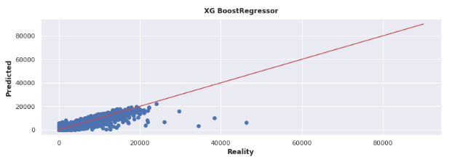
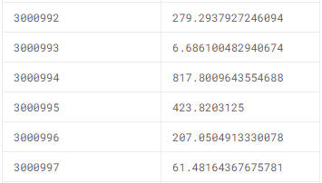

XGB Regression

Slide 8
CONCLUSION
The dataset consists 54 different stores, selling 33 family of products, each having an average of 357 sales per day.
The oil prices tend to have an impact on stores sales, as when oil prices are lower, sales tend to be higher.
XGBoost Regression helped to increase the model performance, with training and testing accuracy of 95.7% and 94.4% respectively.

Slide 9
FUTURE WORK
Implement Consumer/User survey Method
To do worldwide sales prediction for particular product or more

Slide 10
THANK YOU!
Any questions?

